Slide 1

Best Model for Predicting House Prices in Ames, Iowa
Team: J-A-G
Jennifer Thuy Nguyen
Aurora Yucong Hu
Garrett Hastings
Notes:
Intro-2 - G
Data cleaning -2 G
Variable filtering- 1 G
Linear-8
Best subset - Jen
Lasso and Ridge (Garrett)
PCR and PLS (Jen)
Non-linear-7+3
KNN (Garrett)
Other trees (Aurora)
conclusion -2 Jen

Slide 2
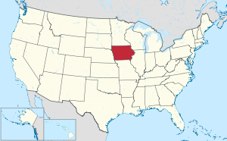
01
02
Introduction
Data Cleaning
03
04
Conclusion
Data Mining Techniques/Algorithms
Dataset
Problem
Concerns
Missing data
Variable Distribution assessment
Dummy variables transformation
Model comparison
Interpretation
Takeaways - Application
Variable filtering
Linear regression Techniques
Non-linear Regression
Notes:
Intro-2 - G
Data cleaning -2 G
Variable filtering- 1 G
Linear-8
Best subset - Jen (done)
Lasso and Ridge (Garrett)
PCR and PLS (Jen) (done)
Non-linear-7+3
KNN (Garrett)
Other trees (Aurora)
conclusion -2 Jen

Slide 3
01
02
Introduction
Data Cleaning
03
04
Conclusion
Data Mining Techniques/Algorithms
Dataset
Problem of Interest
Concerns
Missing data
Variable Distribution assessment
Dummy variables transformation
Model comparison
Interpretation
Takeaways - Application
Variable filtering
Linear regression Techniques
Non-linear Regression
Notes:
Intro-2
Data cleaning -2
Variable filtering- 1 or 2
Linear-10
Non-linear-10+3
conclusion -2

Slide 4

Introduction
Our data is a collection of variables about houses in Ames, Iowa (80 independent variables and house sale price) (www.kaggle.com).
Goal: To find the best model to predict the Selling Price from the given housing features
Possible predictors: neighborhood, square footage of the lot, number of bedrooms, year built, etc.
Possible concerns: missing values, highly skewed variables (high number of zero’s), categorical variable handling, and computational speed

Slide 5
01
02
Introduction
Data Cleaning
03
04
Conclusion
Data Mining Techniques/Algorithms
Dataset
Problem
Concerns
Missing data
Variable distribution assessment
Dummy variables transformation
Model comparison
Interpretation
Takeaways - Application
Variable filtering
Linear regression Techniques
Non-linear Regression
Notes:
Intro-2 (Garrett)
Data cleaning -2 (Garrett)
Variable filtering- 1 or 2 (Aurora)
Linear-10 (Jen)
Non-linear-10+3 (Aurora)
conclusion -2

Slide 6
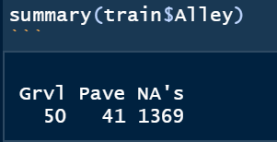
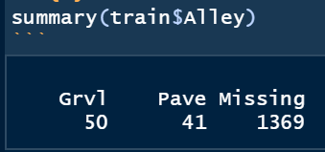
Data Cleaning
Missing categorical entries
Add a new level called "Missing" to store all of the NA's
Missing numerical variables
Replace with median values

Slide 7
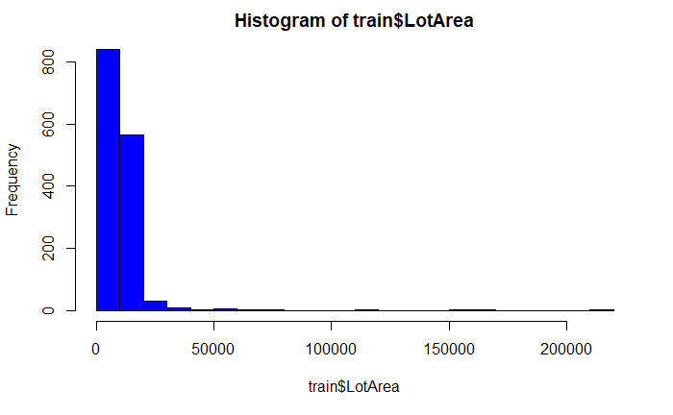
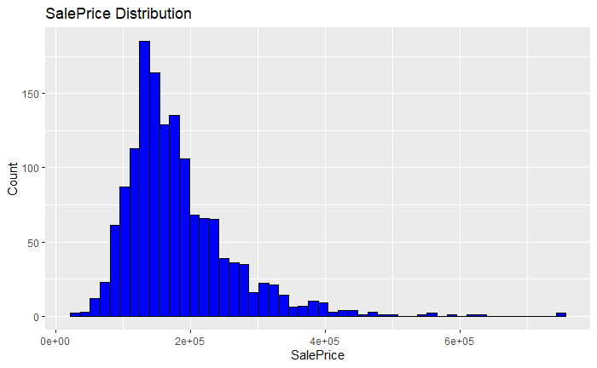
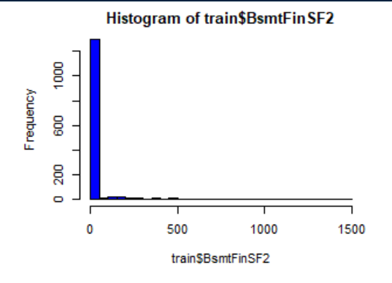
Data Cleaning
Variable Distribution Assessment - Skewness
Log transformation on “LotArea” and “Sale Price” (response variable)
Categorization of several numerical variables into “0” or “More than 0”
(or “1” or “More than 1”)

Slide 8
Data Cleaning
Dummy variables transformation
For each categorical variable, we turned it into multiple dummy variables (each dummy represents one sub-category)
Number of independent variables increases from 80 to 314

Slide 9
01
02
Introduction
Data Cleaning
03
04
Conclusion
Data Mining Techniques/Algorithms
Dataset
Problem of Interest
Concerns
Missing data
Variable Distribution assessment
Dummy variables transformation
Model comparison
Interpretation
Takeaways - Application
Variable filtering
Linear regression Techniques
Non-linear Regression

Slide 10
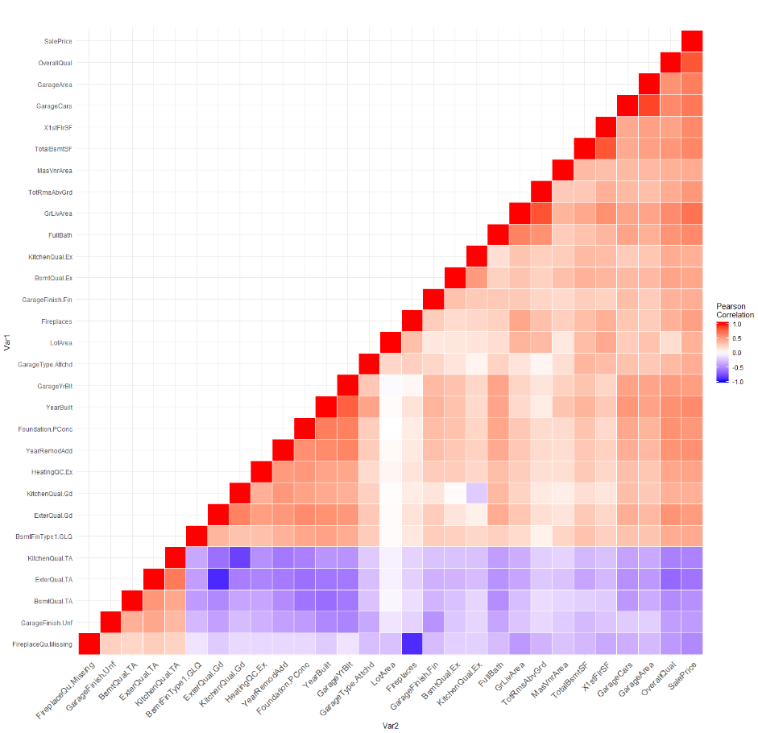
Variable Filtering
Only select predictors with moderately high correlation with response y = SalePrice
abs(Corr(X,Y)) > 0.4
From 314 predictors down to 28 predictors

Slide 11
Linear Regression Techniques
Subset Selection:
Best Subset Selection
Regularization:
Lasso & Ridge
Dimension Reduction:
PCR and PLS

Slide 12
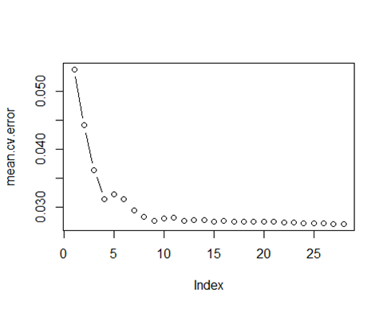
Best Subset Selection
Test MSE: 0.0188, 9 predictors
Pros:
Has simple fitting procedure
Gives sparse model (feature selection)
Assesses all possible subset of variables
Presents the best candidate for a least-squared model with q variables
Cons:
Takes a long time to process large models; computationally expensive

Slide 13
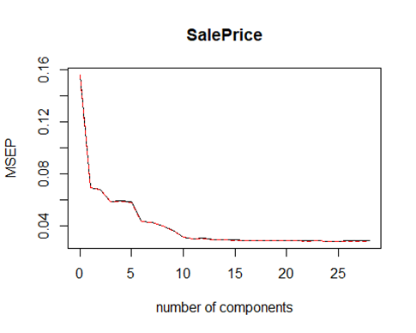
Principal Component Regression
Creates new components from linear combinations of original variables such that they capture as much variability in the predictors as possible
Pros:
Reduces data dimension
Mitigates overfitting
Avoids multicollinearity
Cons:
Does not yield feature selection
The first M principal components, though may best explain the predictors, are not necessarily predictive of the response
Test MSE: 0.0216
28 Variables (10 PCs)
Notes:
if there is some degree of multicollinearity between the variables in your dataset, this procedure should be able to avoid this problem since performing PCA on the raw data produces linear combinations of the predictors that are uncorrelated.

Slide 14
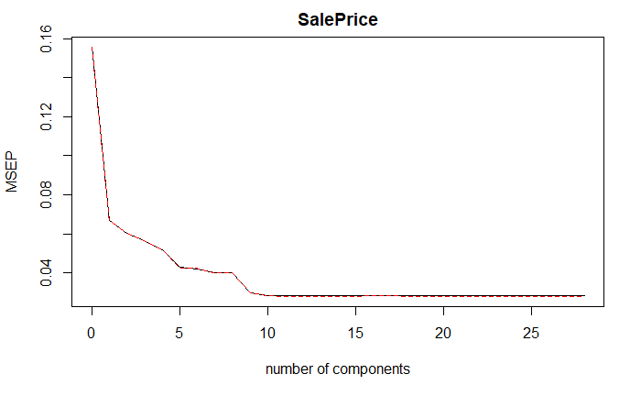
Partial Least Squares
A supervised alternative to PCR - PLS approach attempts to find directions that help explain both the predictors AND the response.
Pros:
All the advantages of PCR
The supervised dimension reduction can reduce bias
Cons:
Does not yield feature selection
The supervised dimension reduction can increase variance => will not perform that much better than PCR
Test MSE: 0.0201
28 Variables (9 components)

Slide 15
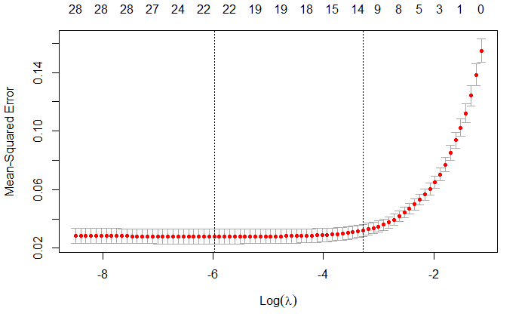
Lasso
Pros
Cons
Test MSE: 0.0184, 23 predictors
Eliminates many variables in its model (sparse)
Can create flexible models that do not rely on hierarchies, unlike forward and backward subset
Gives better predictions than Variable filtering and fwd/bwd stepwise
Interpretability - why does it select certain variables and not others?
Complicated model-fitting procedure (hard to do without statistical software)
The best Log(Lambda) = -5.978623
23 predictors in best model

Slide 16
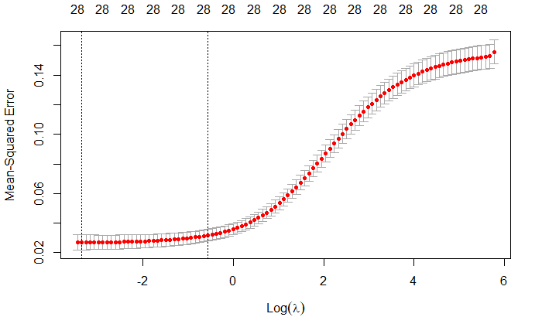
Ridge
Pros
Cons
Test MSE: 0.0191, 28 predictors
Can create flexible models that do not rely on hierarchies, as opposed to forward and backward subset selection
Gives better performance than Lasso if all variables are significant
Does not eliminate any variables (as opposed to Lasso)
Can also lead to high variance due to no variable reduction (high flexibility)
Best log(lambda) = -3.35042

Slide 17
Non-linear Regression Techniques
K Nearest Neighbors
Regression Tree
Bagging &
Random Forest
Boosting

Slide 18
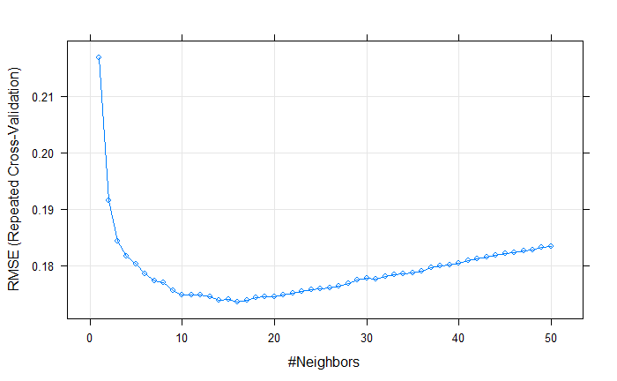
K-nearest neighbors
Pros
Cons
Test MSE: 0.0264, k=16
Non-parametric, more flexible
Offers a more accurate model if the true shape is non-linear
Simple fitting process
Rarely outclass parametric approaches
Does not work well with high dimensions
Difficult to identify importance of variables
Sensitive to noisy data, missing values and outliers
Notes:
http://theprofessionalspoint.blogspot.com/2019/02/advantages-and-disadvantages-of-knn.html

Slide 19
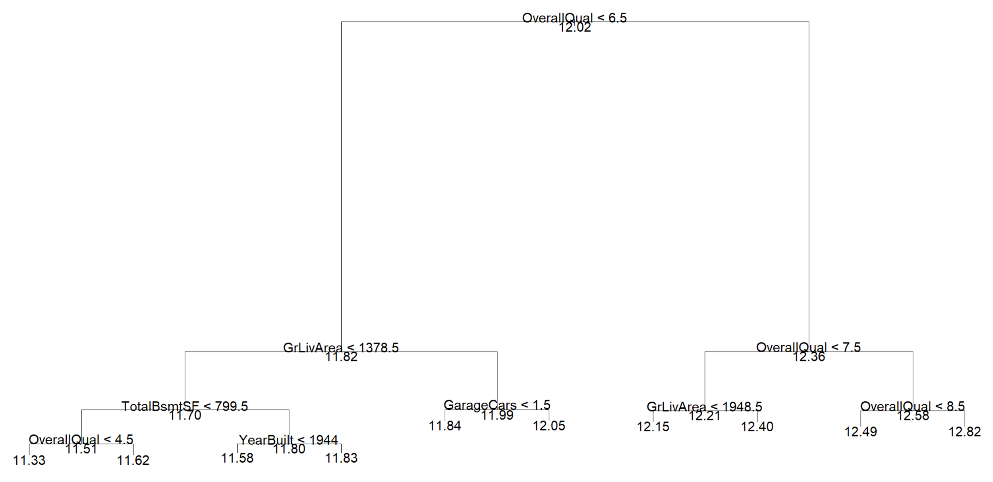
Regression Tree
Test MSE: 0.0443

Slide 20
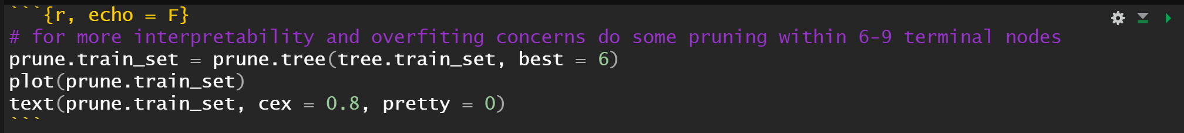
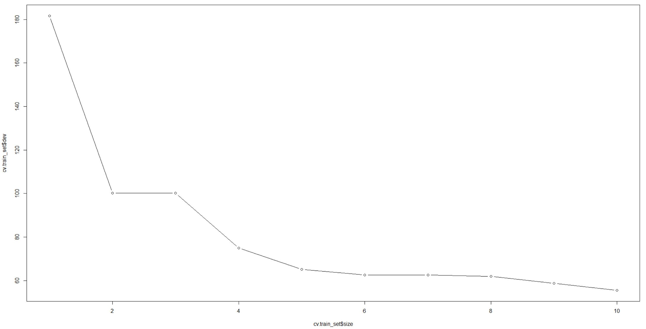
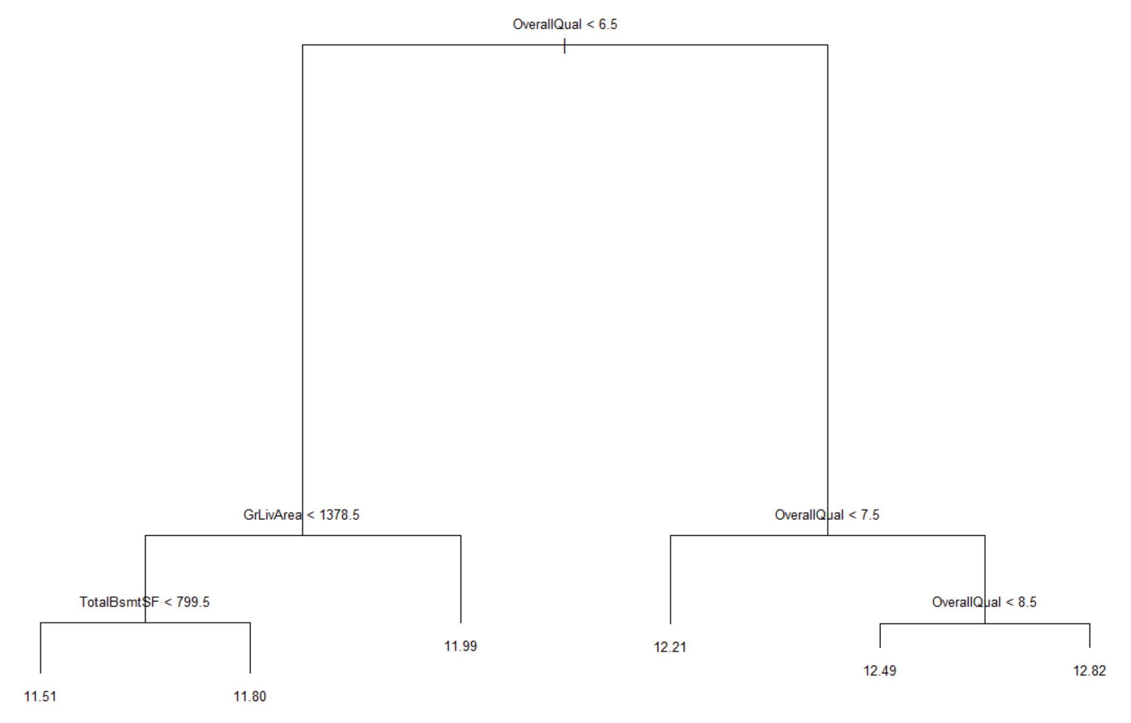
Regression Tree
After pruning (Test MSE): 0.0553

Slide 21
Regression Tree
Cons
Pros
Interpretability & visual representation
Numerical and categorical features accommodation
Little data preprocessing
Feature selection happens automatically
Inflexible: dynamic model adjustment
Unstable
Overfitting, which can be mitigated by:
Limiting tree depth
Minimal # of objects in leaves
Tree pruning

Slide 22
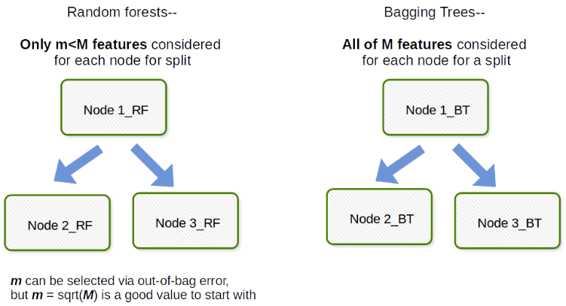
Bagging and Random Forest

Slide 23
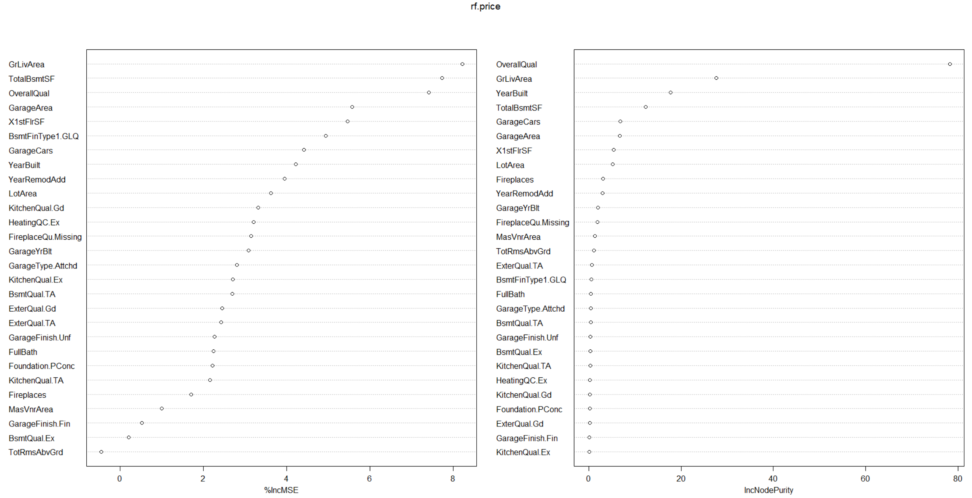
Random Forest

Slide 24
Bagging and Random Forest
Pros
Cons
Test MSE: 0.0194 -- ntree=500, mtry=28
Test MSE: 0.0207 -- ntree=25, mtry=28
Test MSE: 0.0200 -- ntree=25, mtry=20 (RF)
Impressive in versatility
Parallelizable
Robust to outliers and nonlinear data
Low bias, moderate variance
Complexity
High computational resources requirement
Overfit --- solved by tuning hyperparameters

Slide 25
Boosting
Gradient Boosting
Tuning Parameters
N.minobsinnode = c(10,15)
Interaction.depth = c(1,3)
N.tree = c(1000, 1500)
Shrinkage = c(0.05,0,1)
Fits a new predictor in the residuals committed by the preceding predictor
By combining one weak learner to the next learner, the error is reduced significantly over time

Slide 26
Boosting
Tuning Parameters
Test MSE: 0.0173, all predictors
N.minobsinnode = c(10,15)
Interaction.depth = c(1,3)
N.tree = c(1000, 1500)
Shrinkage = c(0.05,0,1)
N.minobsinnode = 10
Interaction.depth = 2
N.tree = 900
Shrinkage = 0.05

Slide 27
Boosting
Pros
Cons
Easy to read and interpret
Resilient method that curbs over-fitting easily
Sensitive to outliers
Almost impossible to scale up

Slide 28
01
02
Introduction
Data Cleaning
03
04
Conclusion
Data Mining Techniques/Algorithms
Dataset
Problem of Interest
Concerns
Missing data
Variable Distribution assessment
Dummy variables transformation
Model comparison
Interpretation
Takeaways - Application
Variable filtering
Linear regression Techniques
Non-linear Regression

Slide 29
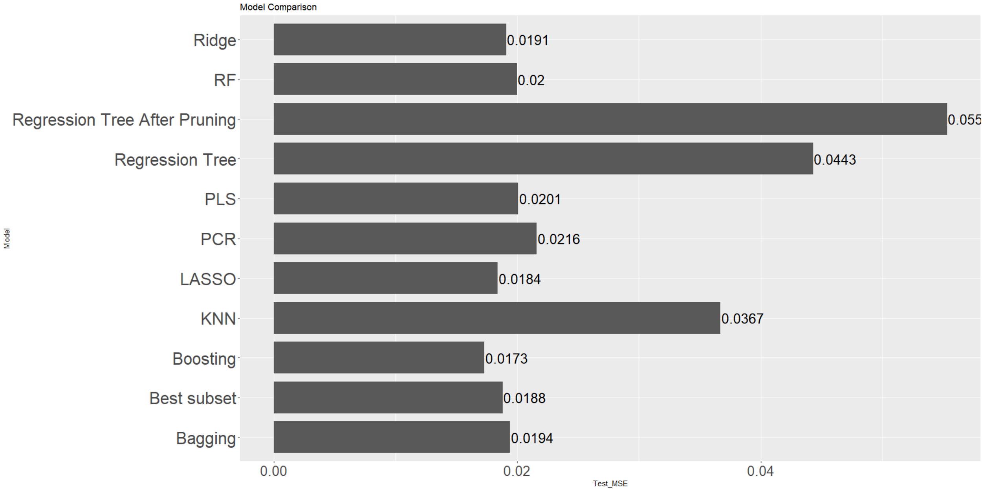
Model Comparison - Test MSE

Slide 30
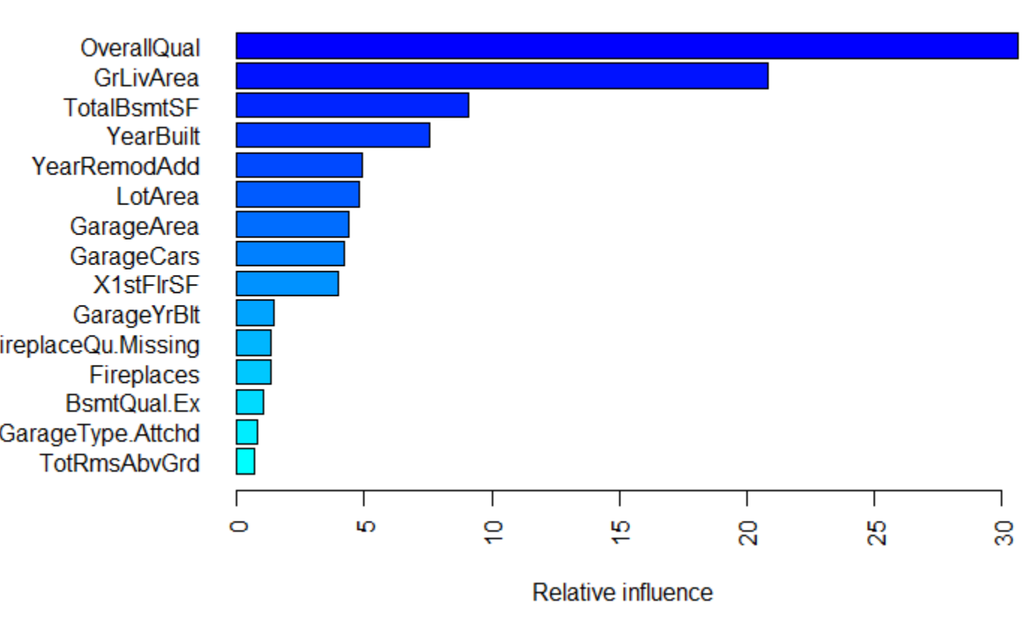
Most important variables from Boosting model

Slide 31
Conclusions
Best method: Gradient Boosting
Performance Accuracy: 86% on average
Most important variables
OverallQual - Overall material and finish quality
GrLivArea: Above grade (ground) living area square feet
TotalBsmtSF: Total square feet of basement area
YearBuilt: Original construction date
Surprises: No location indicator; Garage-related features importance
Improvement: Better handling of high dimension next time without variable filtering

Slide 32
Thanks!
Do you have any questions?
Please keep this slide for attribution.

